Slide 1
GRANULES

Slide 2
Evolution
1984 - Granules India was formed as Triton Laboratories to produce Paracetamol API at our Bonthapally facility in Hyderabad.
1987 - Triton became the second Indian company to export pharmaceutical products to the U.S.

Slide 3
1990 - Triton opened its second manufacturing facility at Jeedimetla to produce multiple APIs.
1991 - Triton laboratories was incorporated into Granules India Limited.
1993 - Granules established its first PFI facility at Jeedimetla.
1995 - Granules became a public company, after having initial public offerings on the Bombay and Hyderabad Stock Exchanges.

Slide 4
2003 - Opened a new large volume PFI facility in Gagillapur.
2003 - Setup a wholly owned subsidiary, Granules USA, for marketing in the US
2005 - a new Paracetamol plant was built in Bonthapally, Hyderabad.
2006 - Granules formed a joint venture with Hubei Biocause to make and sell Ibuprofen API.

Slide 5
2008 - Entered into the Finished Dosage segment.
2010 - Granules received US FDA approval for its first Abbreviated New Drug Application (ANDA).
2011 - Granules-OmniChem, a joint venture with Ajinomoto OmniChem was established to venture into Contract Research and Manufacturing Services (CRAMS) business.

Slide 6
2013 - Established a 10,000 sq. foot R&D facility in Pragathi Nagar, Hyderabad.
2014 - Acquired Auctus Pharma (has 1 api manufacturing at vishakhapatnam and 1 imtermediaries manufacturer in hyderabad)
2014 - Setup a wholly-owned subsidiary in the US; Granules Pharmaceutical to focus on formulation R&D.
  Regulatory approvals are for the plants/ facilities
  Products only include commercial products and no intermediates
  Employees only include staff on the payroll
2015 - Granules entered the Over the Counter business in the US through Granules Consumer Healthcare (GCH).

Slide 7
Overview
PARTICULARS | VALUE
Countries | >75
Manufacturing sites | 8
Customers | >300
Team strength | 2325
World's largest PFI facility
Industry Growth:- 3% - 4% whereas Company growth :- 4%
Revenue from operations : - 1431 crore rupees
Refer to this:
  https://economictimes.indiatimes.com/granules-india-ltd/infocompanyhistory/companyid-6991.cms

Slide 8
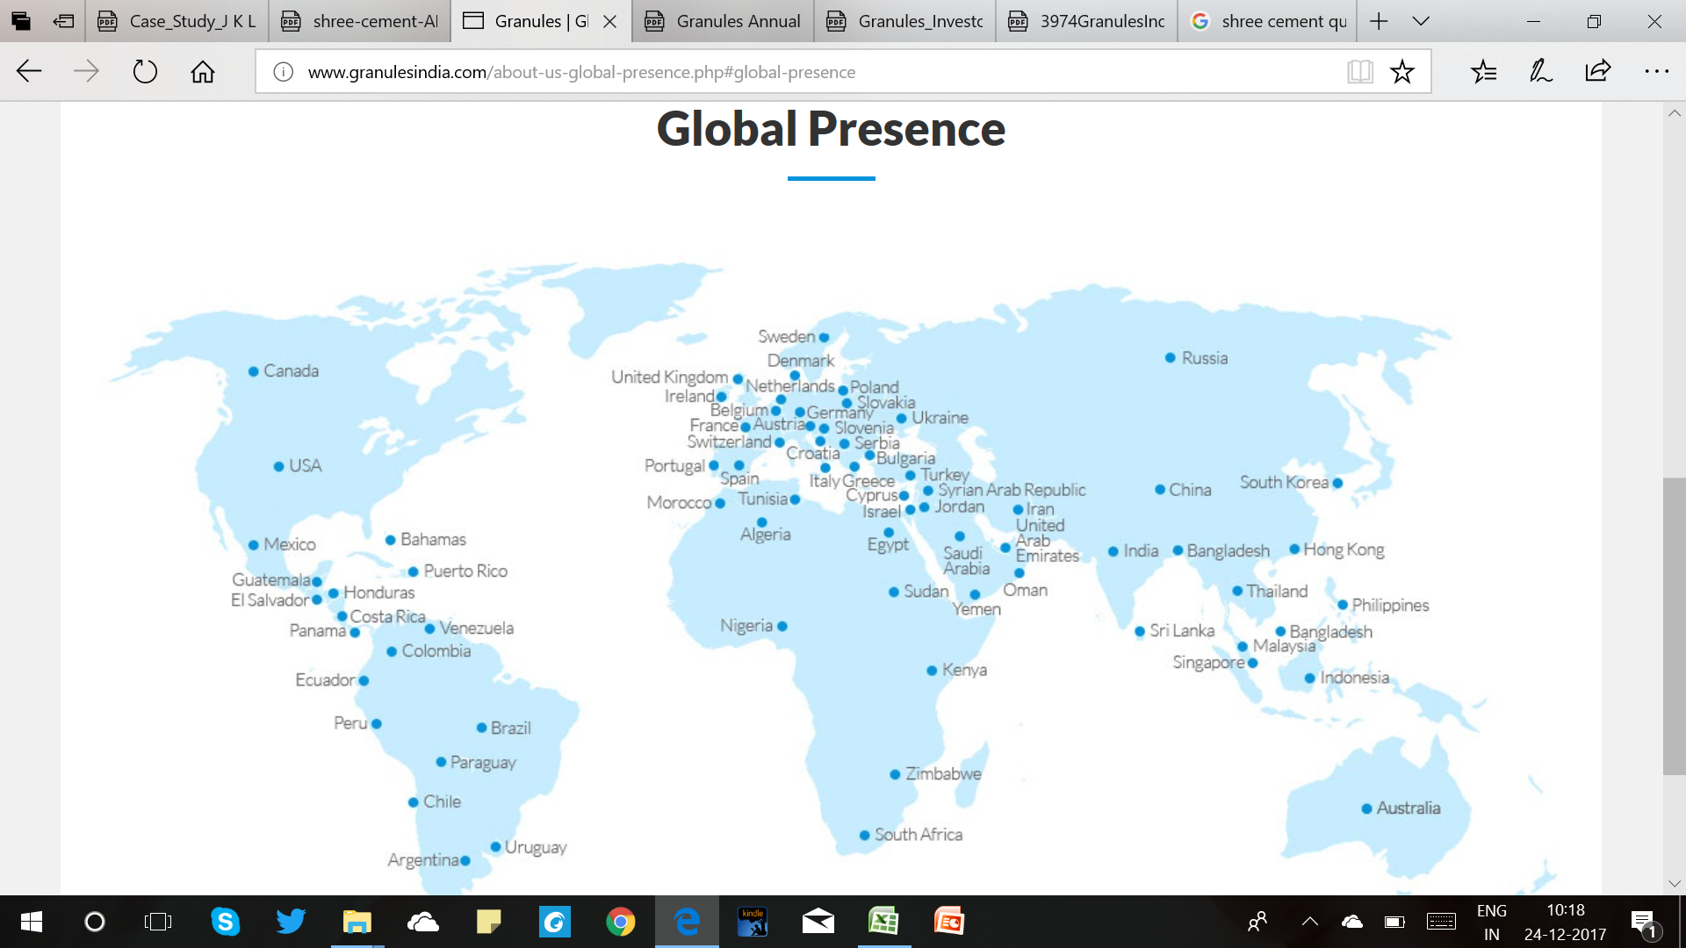

Slide 9
ALLIANCES
Granules Biocause:
  Hubei Biocause China, manufactures Ibuprofen at a plant in central China with a 4,800 TPA installed capacity.
  The JV ensures a regular supply of raw material to support Granules’ growing penetration into both, OTC & prescription finished dosages.
Granules Omnichem:
  Ajinomoto OmniChem, a Belgian company that specializes in contract manufacturing of intermediates and APIs for innovator companies
  provides an entry into the CRAMS market, without a significant outlay in R&D.
  focuses on complex APIs in therapeutic segments, such as CVS, CNS and oncology.

Slide 10
Organisational structure
Granules India
Granules USA Inc.
Granules Pharmaceuticals Inc.
Granules Europe Inc.
Granules OmniChem
Granules Biocause

Slide 11
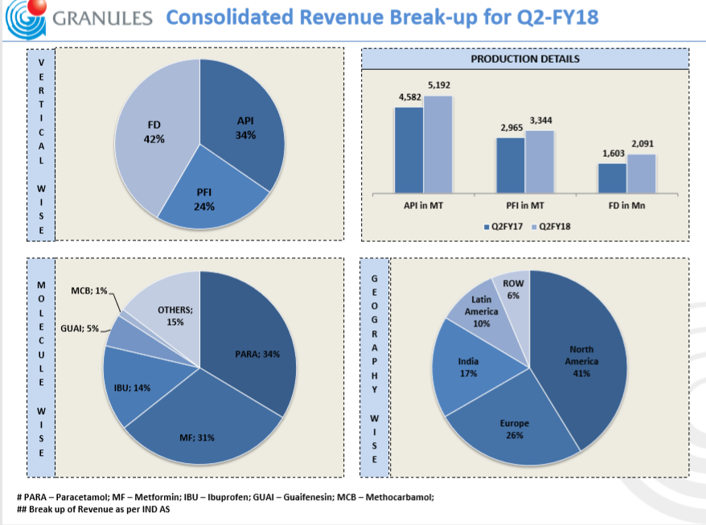

Slide 12
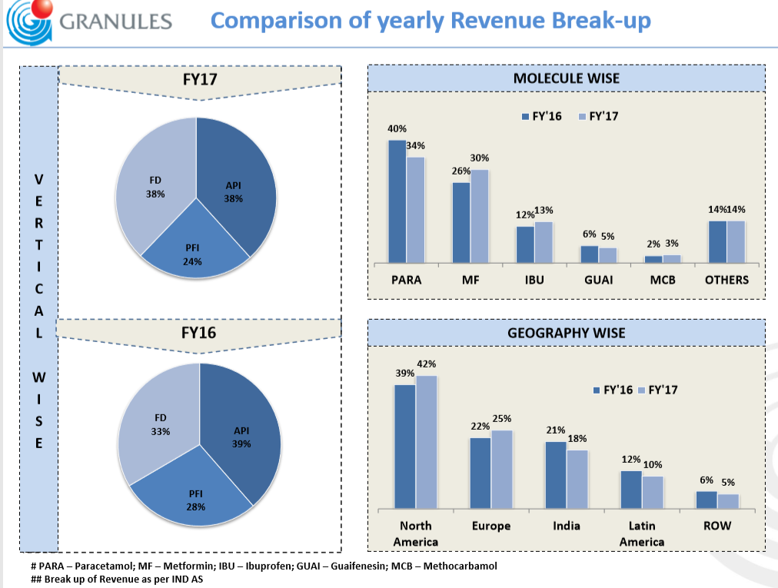

Slide 13
R&D DATA
PARTICULARS | VALUE | SOURCE
Revenue from operations | 13,74,16,90,000 | Annua report pg 95
R&D Projects | 1 api R&D (hyderabad) 2 formulations R&D (hyderabda and virginia) 1 process R&D (pune) | Annua report pg
Number of scientists | 140+ | Annual Report pg 43
R&D expense | 26,13,37,000 | Annua report pg 44
R&D as a percentage of Revenue | 1.90%

Slide 14
Pharma Business Revenue (1,374.169 CRORES)
API(38%)
FD(38%)
PFI (24%)
 | API | PD | PFI
2015-16 | 33% | 39% | 28%
2016-17 | 38% | 38% | 24%
Growth rate | 15.15% | -2.56% | -14.29%
While API and PFI revenues of the company grew by a 6-year CAGR of 21% and 12% respectively, its formulations sales shot up at a 45% CAGR in the corresponding period .
It not make api for patented drugs, makes for complex and simple generics

Slide 15
Geography
Segment
INDIA (18%)
Export
LATIN AMERICA (10%)
AMEA (4%)
CANADA (4%)
Actue Product
( 60-75%)
Chronic Product (25-40%)
API(522.18 CRORES)
EUROPE (25%)
US (38%)
AUSTRALIA (1%)

Slide 16
Export Market (82%)
Exchange Rate risk :
  Much of GIL’s revenue accrues from exports, but at the same time a large component (around 40%) of its raw material requirements is imported. Hence, the company enjoys a natural hedge. Also, much of GIL’s debt is in foreign currency. Additionally, GIL has clauses in most of its contracts, wherein it adjusts the selling price based on the forex rate.

Slide 17
US CHANNEL CONSOLIDATION
pharmacy benefit managers (PBMs):
  They are Drug distributers
  Only 3:
    CVS Caremark
    Cardinal Health
    AmerisourceBergen
  sell them to retail drugstore chains like Walgreen, Alliance Boots, Rite Aid and Shoppers Drug Mart
16 mergers and acquisitions were reported in 2012 and 10 in the following year.
The top five dispensing pharmacies accounted for approximately 65% of 2013 US prescription dispensing revenues
SOURCE:
  (http://indianexpress.com/article/business/companies/consolidation-in-us-hurts-indian-generic-firms-dr-reddys-lab-sun-pharma/)

Slide 18
NATURE OF INDUSTRY
Branded drugs with sales of up to $135 billion expired by the end of 2015
With patents for drugs worth over $100 billion due for expiry by FY2022, demand for low manufacturing by innovators as well generic alternatives by the overall regulated markets have been posing immense opportunity for the Indian counterparts
US alone accounts for nearly 46% of the $1 trillion global pharmaceutical industry with generic penetration of only 20% (by value)
Latin American pharma markets are the fastest growing at nearly 11% against global average of 3%.

Slide 19
PRODUCTS

Slide 20
ACTIVE PHARMACEUTICAL INGREDIENTS (APIs)
We are one of the global leaders in Ibuprofen, Paracetamol, Metformin, Guaifenesin and Methocarbamol.
We serve the needs of our customers through four API facilities and one intermediate facility in Hyderabad and Vizag.
Product categories include anti- retrovirals, anti- hypertensives, anti-histamines, anti- infectives, analgesics, anti-coagulants, anti-fibriotics and platelet inhibitors.

Slide 21
PHARMACEUTICAL FORMULATION INTERMEDIATES (PFI)
We entered into this business segment in the early 90s, following an insight that most finished dosage manufacturers were not efficiently producing PFIs because they only created large-volume products in limited quantities.
PFI manufacturing accounts for 80% of the total cost of a finished dosage.
Granules manufacture in bigger batch size (six ton) to be cost efficient.

Slide 22
FINISHED DOSAGES (FDs)
We provide unique extended release (ER) tablets.
We are the only Indian pharmaceutical player to manufacture ‘pressfit’ (rapid release tablets) dosages and are among the few to manufacture bi-layered tablets.
Focus on formulation R&D and low volume manufacturing by leveraging a niche technology that enables us to make dosage forms with specific release capabilities like pulsatile drug release in tablet and capsule dosage form , orally disintegrating modified release tablets (XR, MR, ER), modified release suspension and controlled substances capabilities in an abuse deterrent technology platform .

Slide 23
SPECIALITY PRODUCTS
Oncology, High Potent APIs & Finished Dosage Forms
in 2014, Granules’ venture into the development of APIs forward integrated into finished dosages within the Oncology therapeutic segment.
At the Granules Research Center, we develop the APIs within this segment along with other high potent APIs. Our R&D team possesses a unique expertise in physical properties and polymorphism screening, generation, characterisation and stabilisation. These APIs will be manufactured at a state of art manufacturing facility spread across 18 acres, currently under construction in Vizag.

Slide 24
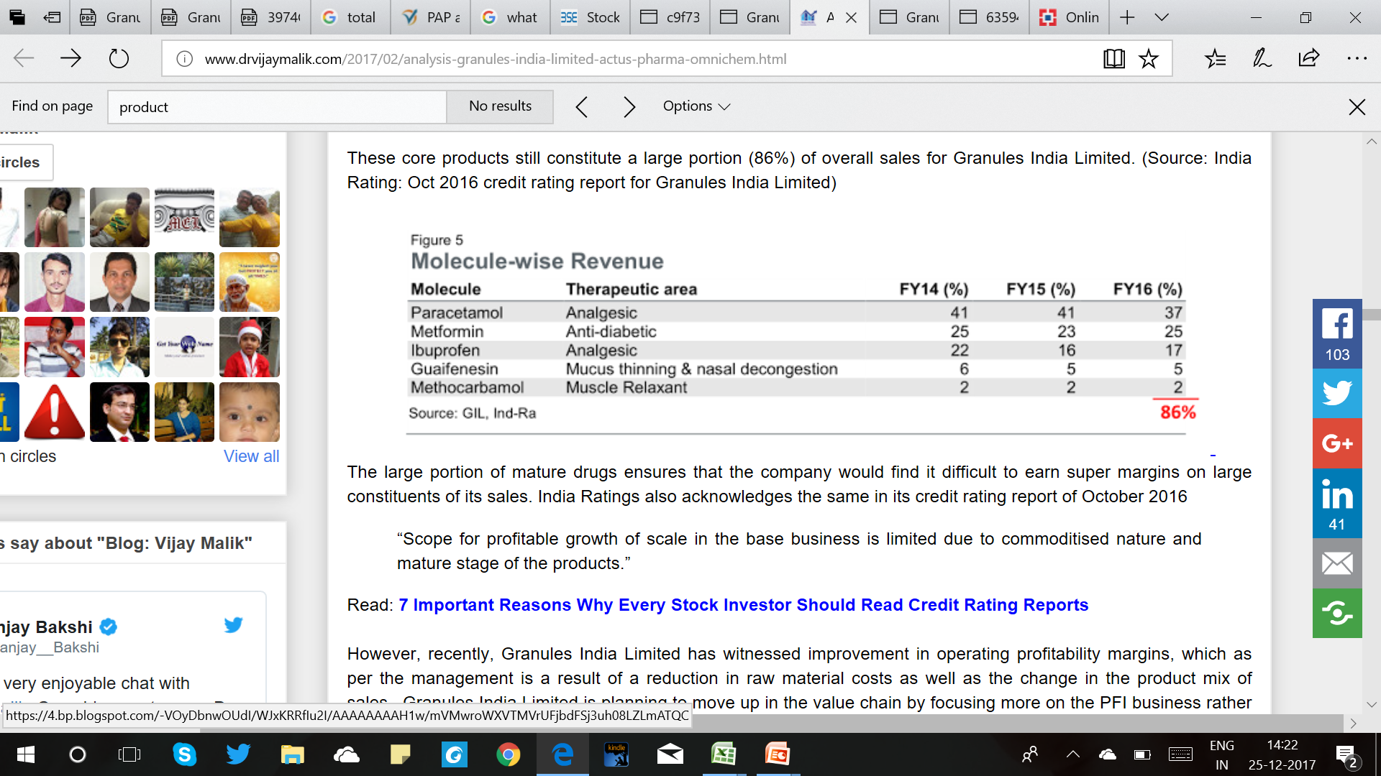
MOLECULE - WISE

Slide 25
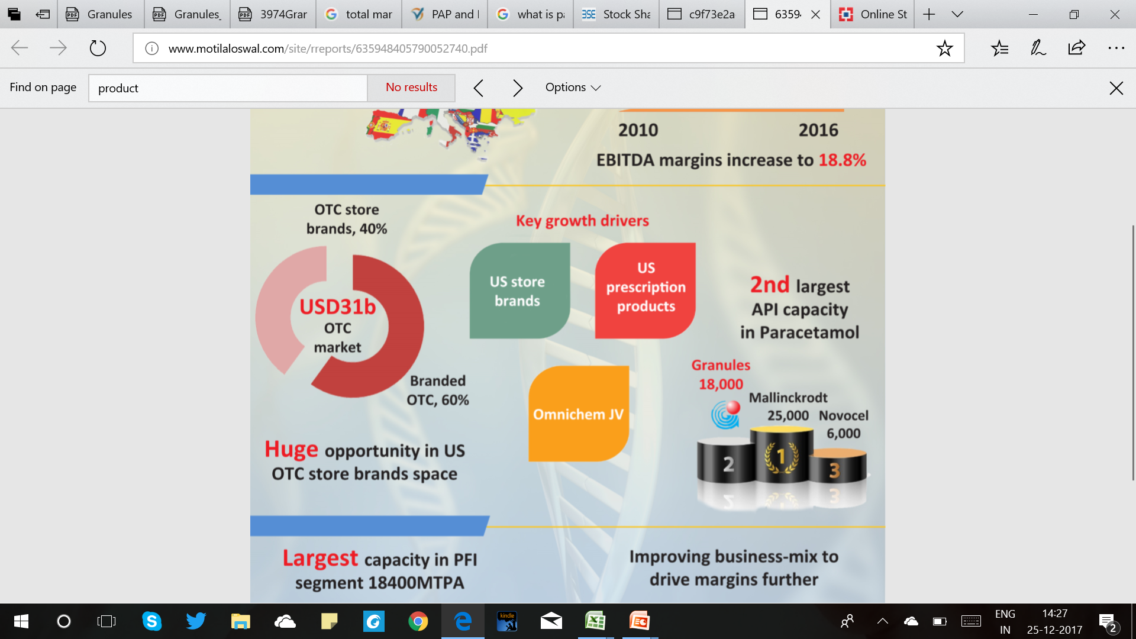
Paracetamol (NLEM)
Paracetamol or Acetaminophen is a widely used OTC molecule for symptoms of pain, fever and allergies with an estimated market size of USD832 million. The molecule, being largely sold as **generic generics**, is highly competitive owing to the dominance of low-cost, high-volume players. Mallinckrodt and Granules are the major players with an estimated 85%+ share in the overall volumes.
While Mallinckrodt, a dominant industry player previously, shifted its growth strategy from generics to brands leading to larger captive utilization of paracetamol capacities, it paved the way for the next big player to absorb its API market share.

Slide 26
Metformin (NLEM)
GIL has been a key supplier of Metformin PFI and FDs for direct sales in the US as well as contract manufacturing. With an initial capacity of 2,000 TPA at its Jeedimetla facility, the company began to procure APIs from third parties to meet growing demand. As part of its future growth strategy, GIL has added Metformin capacity of 7,000 TPA at its Bonthapally facility.

Slide 27
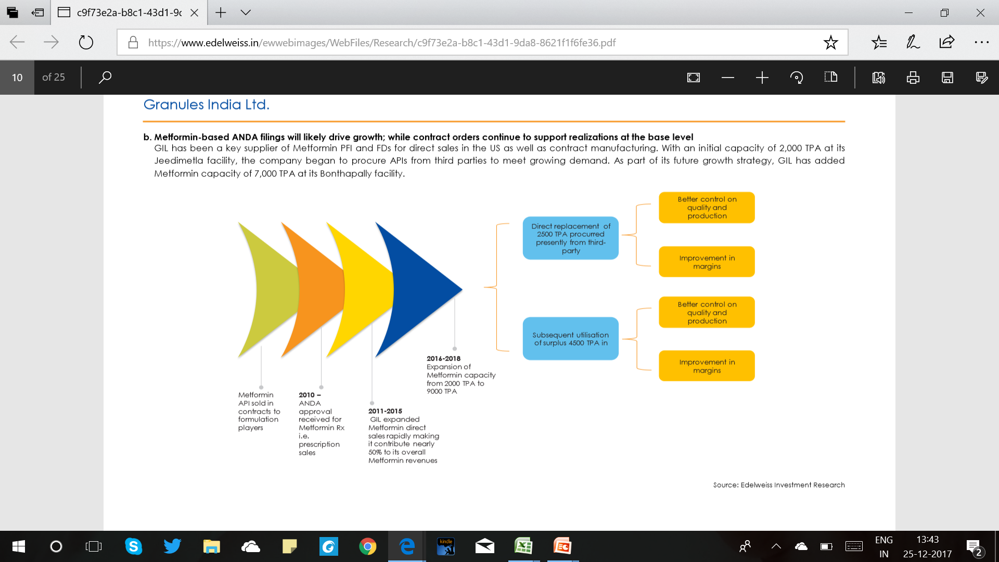

Slide 28
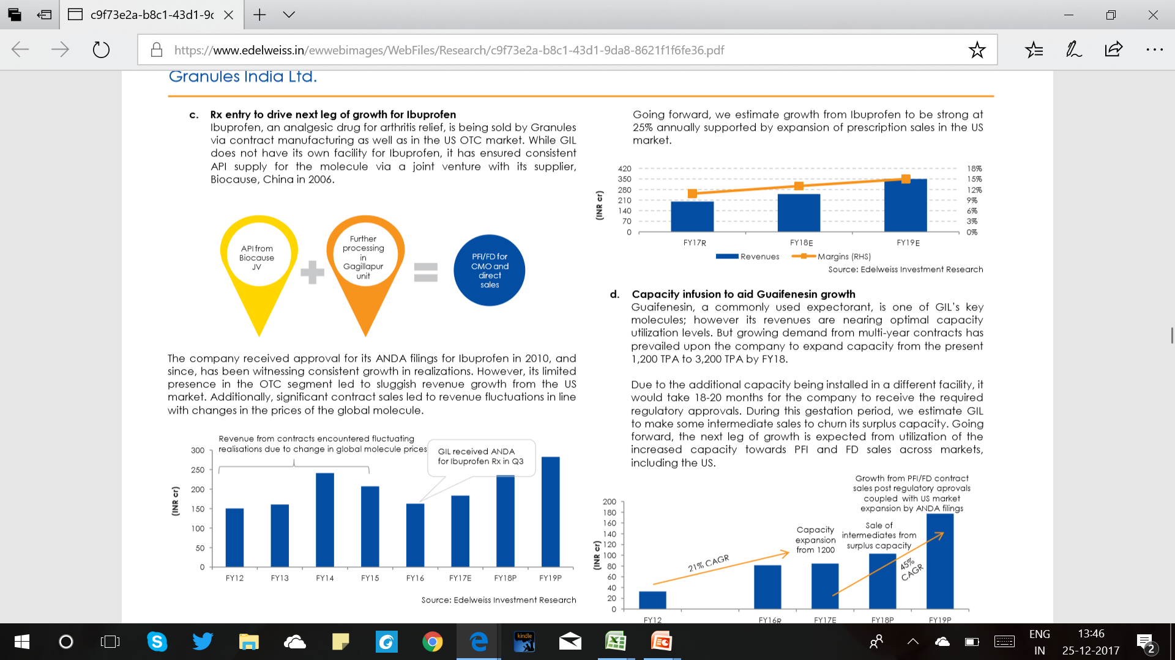
Ibuprofen (NLEM)
Ibuprofen, an analgesic drug for arthritis relief, is being sold by Granules via contract manufacturing as well as in the US OTC market. While GIL does not have its own facility for Ibuprofen, it has ensured consistent API supply for the molecule via a joint venture with its supplier, Biocause, China in 2006.

Slide 29
Guaifenesin
Guaifenesin, a commonly used expectorant, is one of GIL’s key molecules; however its revenues are nearing optimal capacity utilization levels. But growing demand from multi-year contracts has prevailed upon the company to expand capacity from the present 1,200 TPA to 3,200 TPA by FY18.

Slide 30
JOINT VENTURES AND SUBSIDARIES

Slide 31
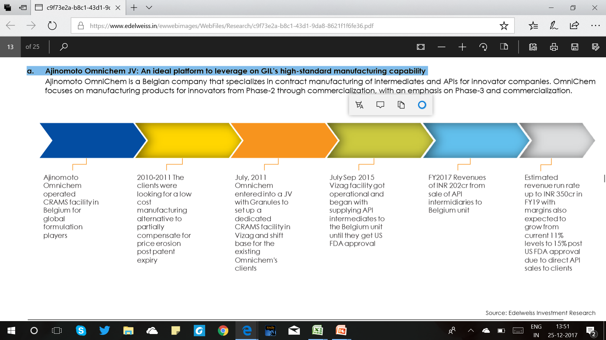
Ajinomoto Omnichem JV
An ideal platform to leverage on GIL’s high-standard manufacturing capability.

Slide 32
US Pharma
Building a product bouquet for US generics offering.
GIL is getting ready to establish itself as a key generic-generic player in the US market. It can leverage its low-cost capabilities and increase margins through higher realizations from direct formulation sales. In line with this vision, the company began with ANDA filings for its key molecules such as Metformin and Ibuprofen, coupled with in-licensing deals and acquisitions.
With its formulations manufacturing facility already set up in Virginia, the company has entered into a deal with US Pharma, a US-based pharma R&D organization to get the first right of refusal for manufacturing and distributing their products in the US. The deal is a win-win for both entities considering US Pharma’s R&D strength and GIL’s manufacturing and distribution strengths. In addition, GIL has also procured the marketing and distribution license for four of US Pharma’s products that are being manufactured by Windlas Pharma.

Slide 33
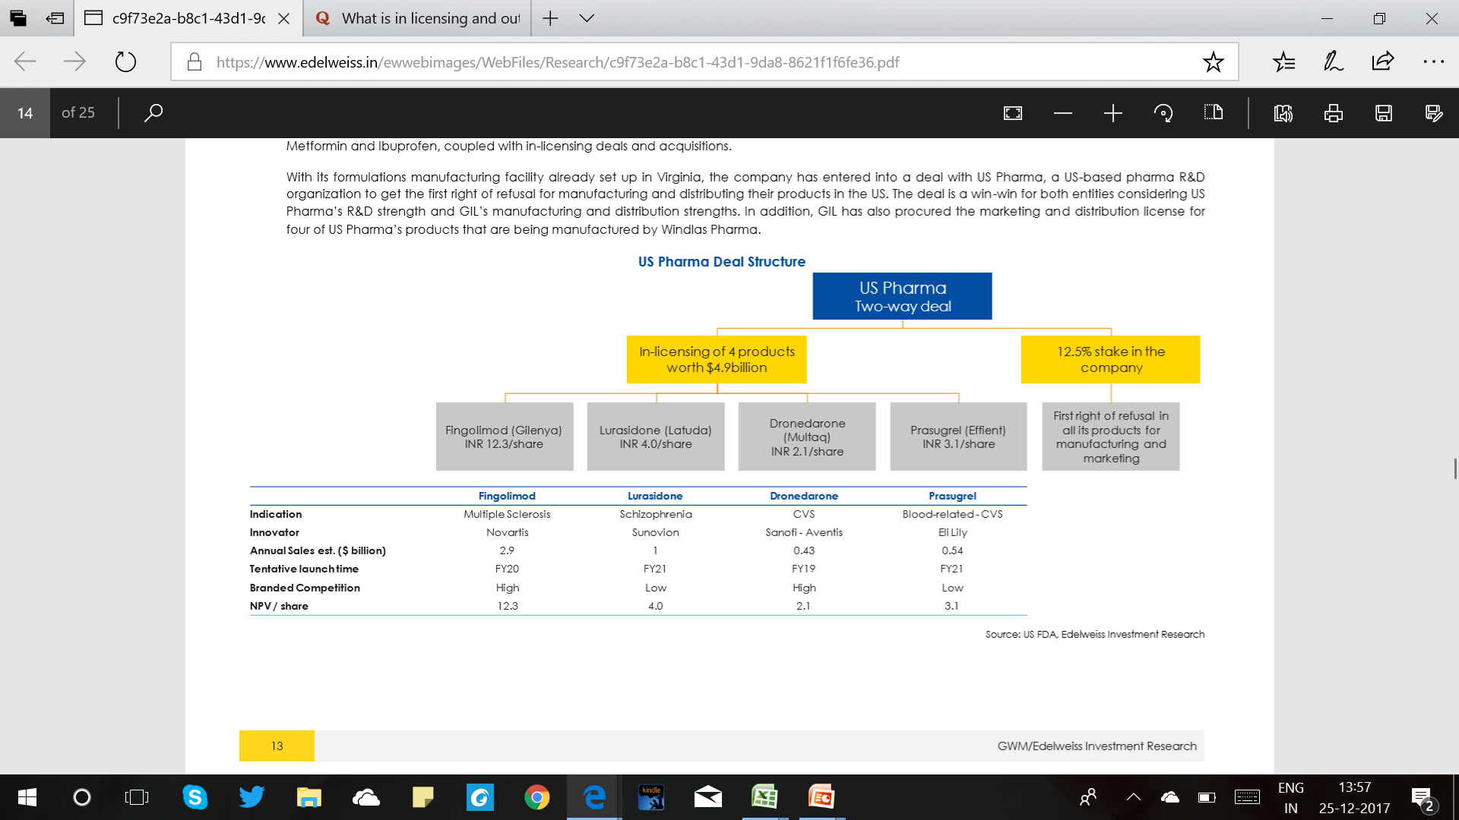

Slide 34
Auctus
In 2013, Granules identified several molecules that it wanted to produce and thereby expand its portfolio. Since Auctus already had an approved facility in Vishakhapatnam for regulated markets, this acquisition allowed Granules to reduce the time-to-market by around 3 yrs versus a greenfield project.
The acquisition gives Granules access to the manufacturing knowhow for 14 low-volume, high-value APIs across various therapeutic areas like CVS, GI, anti-histamine, etc.. However, the company discontinued several of these products due to operational inefficiencies leading to losses for the unit. Currently, GIL has filed DMFs for gTecfidera and gEsbriet from this facility (and for which ANDAs have been filed by its partners). While their launch is expected post the exclusivity periods in FY19 and FY22 respectively, this gives clarity about revenue expectations from this facility.

Slide 35
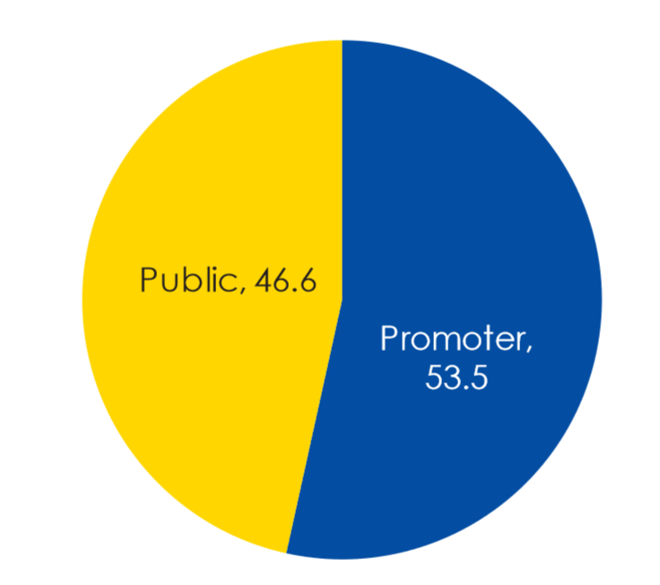
FINANCIALS

Slide 36
The company’s revenue has grown at a 16% CAGR over FY12-17
Expanding margins on the back of improving product-mix
As product mix improved towards higher FD sales, EBITDA margins of the company also expanded from 11-12% levels in FY12 to 21% in FY17. While GIL is adding API capacity, it is expected to utilize a significant portion of this additional capacity internally towards formulations. Thereby, the company will witness higher efficiency from backward integration as well as economies of scale.
The company has plans to fund more than 70% of its capex from internal accruals and equity dilution. Further, with reducing debt/equity ratios, their ability to raise funds in the future holds strong ground.

Slide 37
Capital Allocation
Capex of about INR 1,100 crore towards capacity expansion and specialty greenfield projects will be partly completed in FY18 and partly by FY21. Company has raised funds from debt, internal accruals and also received board approval to raise INR 500 crore from QIP for this purpose.
GIL has an ongoing capex of INR 280 crore for building API capacities in its key molecules as its existing facilities are approaching maximum utilization levels.
Nearly 6000 TPA capacity expansion in paracetamol coupled with 5000 TPA in Metformin and 2000 TPA in Guaifenesin will aid in sustaining the near 25% annual top-line growth from these molecule

Slide 38
Profitability
The shift from API to PFIs and FDs will ensure that the margins will improve
At present, only 31% of sales come from the high margin formulations business and there is scope for improvement.

Slide 39
OTC MARKET

Slide 40
Rx-to-OTC switch
According to Perrigo, branded prescription drugs with sales potential of USD37b are likely to take on OTC status over the next five years primarily on account of the following reasons:
  (1) lower cost of OTC drugs delivers greater healthcare efficiency
  (2) insurance programs are encouraging the use of OTC drugs
  (3) population in the US is growing and aging.

Slide 41
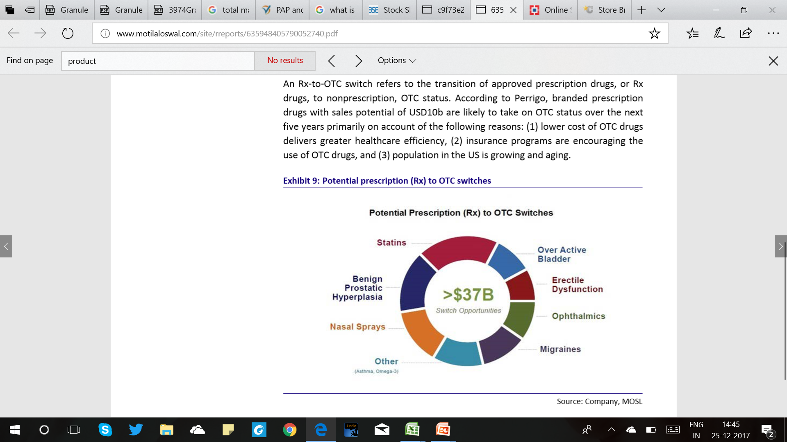

Slide 42
Store brands account for nearly 40% of total OTC sales and 60% of total OTC volumes in the US. These are typically sold through multi-brand retailers like Walmart, Walgreens, CVS, Krogger, etc. Currently, Perrigo dominates this market, with 45% market share (second best ‘LNK’ at 15%).
On an average, the cost of store brands is ~36% lower than branded OTC drugs.
Until FY14, GRANULES used to supply three OTC products to Perrigo, which sold these through its retail chain. However, in FY15, the company terminated this supply arrangement with Perrigo (loss of sales of INR1.1b/USD16m in FY16) and entered the store brands market with its own marketing field force.

Slide 43
Advantages of Granules in OTC:
GRAN is a vertically integrated company, with large capacities to produce OTC products like Paracetamol, Ibuprofen, and Guaifenecin. It has the ability to offer large discounts.
GRAN has substantial experience in the store brands business; it was present in the supply chain with Perrigo for more than five years.
GRAN has three OTC approvals for Paracetamol, Ibuprofen 200mg, and Naproxen 200mg tablets.
To leverage its existing field force and increased product offerings, GRAN has initiated a tie-up with Par Pharma to launch generic OTC Zegerid in the US OTC market.

Slide 44
Initiatives to integrate forward:
Granules Consumer Healthcare (GCH) :
  carrying forward to the retail front will let us work directly with the end customer

Slide 45
THANK YOU

